Slide 1
FUNDAMENTALS OF ANALOG COMMUNICATION

Slide 2
What is Communication?
What are the different means of Communication?

Slide 3
Basic Communication System

Slide 4
→Info Source
→Input Transducer
→Transmitter
→Channel/ Medium
→Noise
→Receiver
→Output Transducer
→Destination

Slide 5
Modulation:
Process of varying one or more properties of a periodic waveform, called the carrier signal, with a modulating signal that typically contains information to be transmitted.
Need for Modulation:
1.To enable long distance communication
Low frequency message; High frequency carrier
2.To reduce the height of the antenna
Antenna height is a function of wavelength λ
λ inversely proportional to frequency; Lower frequency signal requires antenna of much height which is not practical
3.For multiplexing
A method by which multiple analog or digital signals are sent over a shared medium

Slide 6
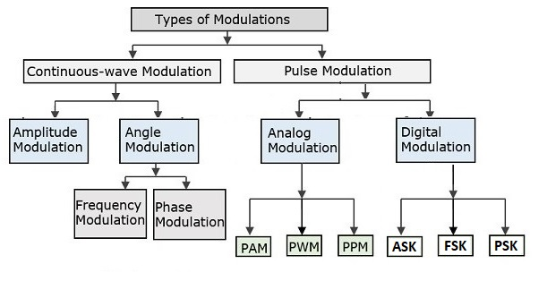
Classification of Modulation

Slide 7
Amplitude Modulation
Process of varying the amplitude of the carrier wave proportional to the instantaneous amplitude of modulating signal(message signal)
Both Carrier and Message are analog
Modulating Signal(Message) + Carrier Signal = Amplitude Modulated Signal

Slide 8
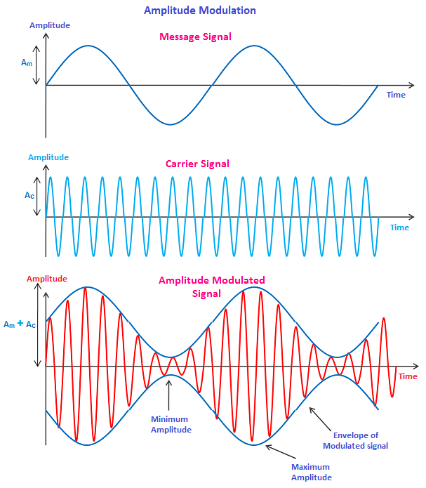
Waveforms

Slide 9
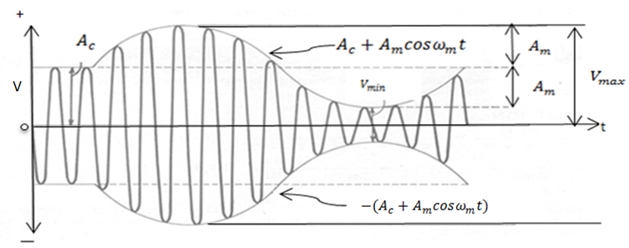

AM Signal in detail
Message signal: m(t)= $Am$ Cos (2πf_{m}t) Carrier signal: c(t)= A_{c} Cos (2πf_{c}t)
AM signal s(t) = $\left\{\text{A}\text{c}\text{+}Am\text{Cos} \text{(2}\text{πfmt}\text{)}\right\}$ Cos (2πf_{c}t)
Where, $Am$ , A_{c} $\text{are}$the amplitude of message signal & carrier
f_{m} $\text{,}$ f_{c} $\text{are}$the frequencies of message signal & carrier

Slide 10
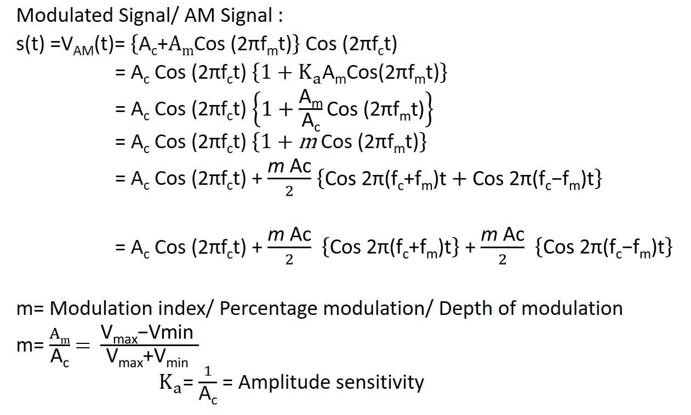

Slide 11

Modulation Index
Decides the depth of modulation. Expressed as percentage
→Under modulation when $m<1$
→ Over modulation when $m>1$
→ Perfect modulation when $m=1$

Slide 12
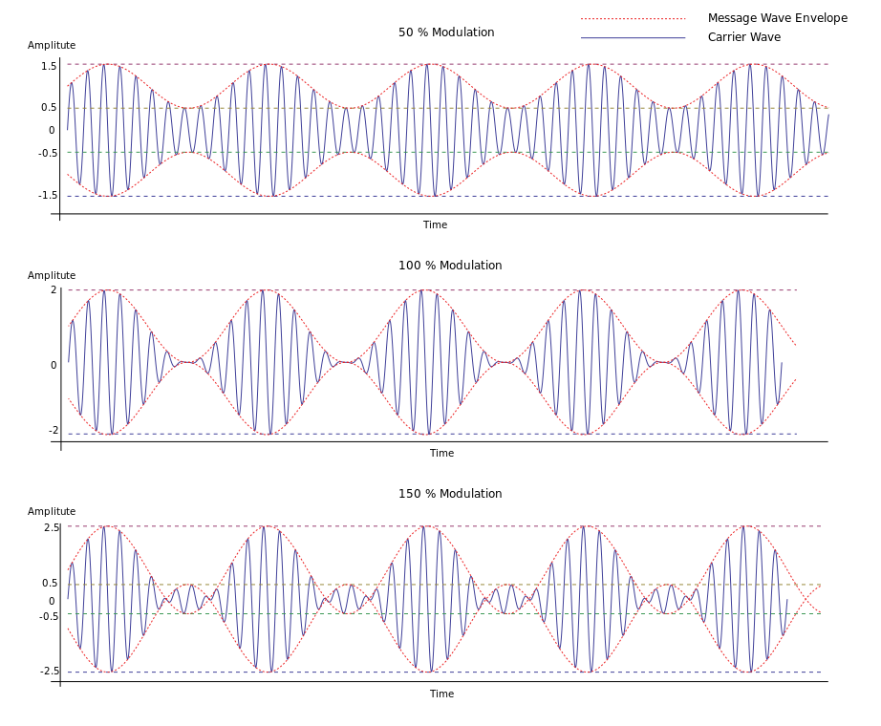
Effect of modulation index on AM wave
m=0.5
.
m=1.0
m=1.5

Slide 13
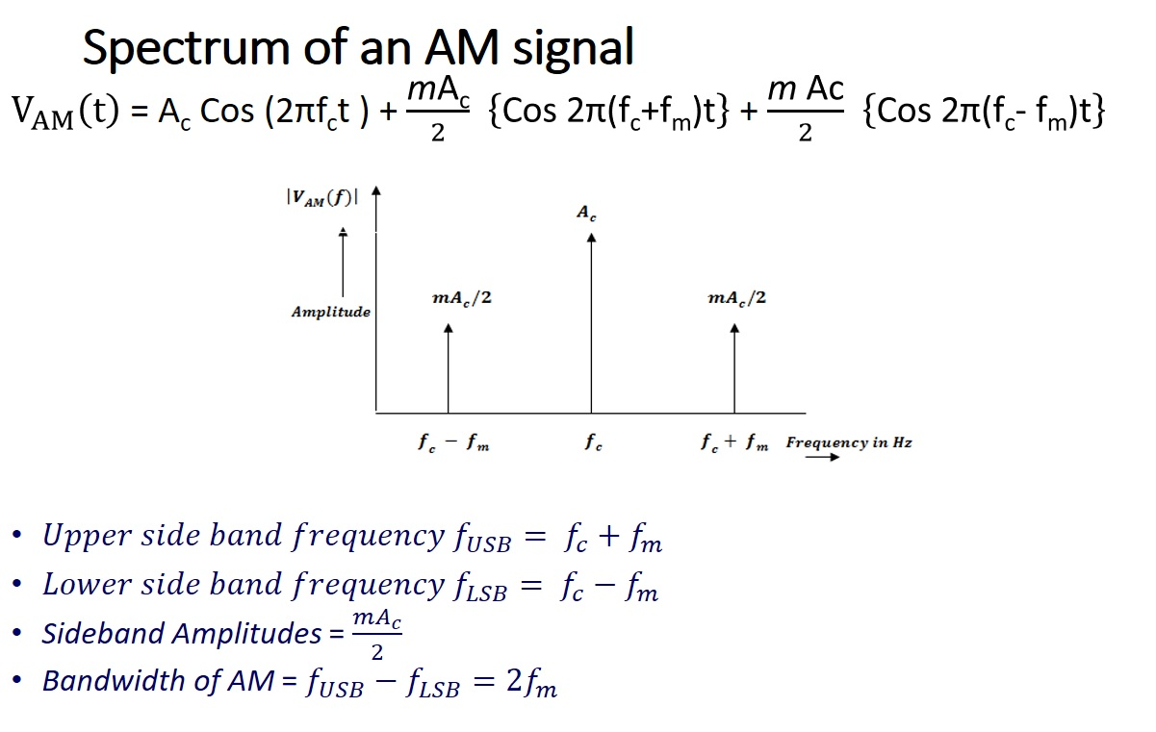
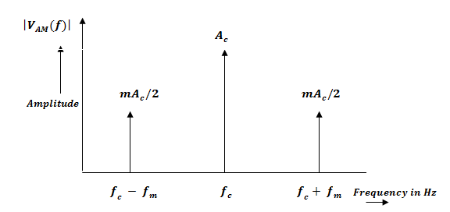

Spectrum of an AM signal
$V_{AM}\left(t\right)$ = A_{c} Cos (2πf_{c}t ) + $\frac{\text{m}\text{A}\text{c}}{2}$ $\left\{\text{Cos} \text{2}\text{π}\text{(}\text{f}\text{c}\text{+}\text{f}\text{m}\text{)}\text{t}\right\}$ + $\frac{\text{m} \text{Ac}}{2}$ $\left\{\text{Cos} \text{2}\text{π}\text{(}\text{f}\text{c}\text{− }\text{f}\text{m}\text{)}\text{t}\right\}$
${Upper side band frequency f}_{USB}= f_{c}+f_{m}$
${Lower side band frequency f}_{LSB}= f_{c}−f_{m}$
Sideband Amplitudes = $\frac{mA_{c}}{2}$
Bandwidth of AM = $f_{USB}−f_{LSB}=2f_{m}$

Slide 14
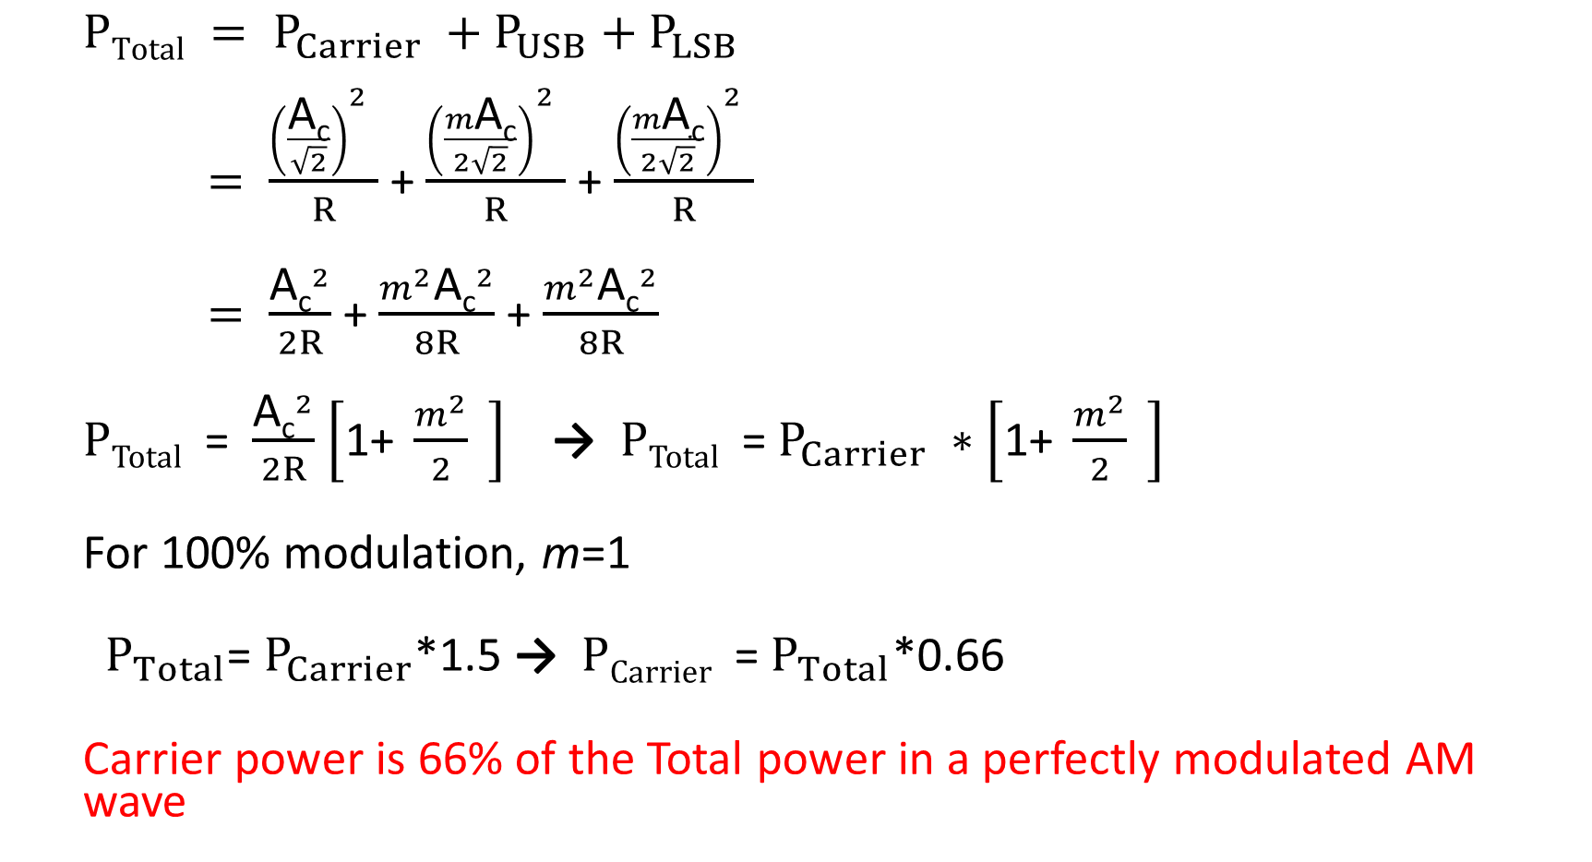
Power in an AM Wave
$$PTotal = P_{Carrier} +P_{USB}+P_{LSB}$$
$= \frac{{\left(\frac{\text{A}\text{c}}{\sqrt{2}}\right)}^{2} }{R}$ + $\frac{{\left(\frac{m\text{A}\text{c}}{2\sqrt{2}}\right)}^{2} }{R}$ + $\frac{{\left(\frac{m\text{A}\text{c}}{2\sqrt{2}}\right)}^{2} }{R}$
$= \frac{{\text{A}\text{c}}^{2}}{2R}$ + $\frac{m^{2}{\text{A}\text{c}}^{2}}{8R}$ + $\frac{m^{2}{\text{A}\text{c}}^{2}}{8R}$
$PTotal$ = $\frac{{\text{A}\text{c}}^{2}}{2R}$ $\left[\text{1+} \frac{m^{2}}{2} \right]$ → $PTotal$ = $P_{Carrier} ∗\left[\text{1+} \frac{m^{2}}{2} \right]$
For 100% modulation, m=1
$P_{Total}$= $P_{Carrier}$*1.5 → $PCarrier$ = $P_{Total}$*0.66
Carrier power is 66% of the Total power in a perfectly modulated AM wave

Slide 15
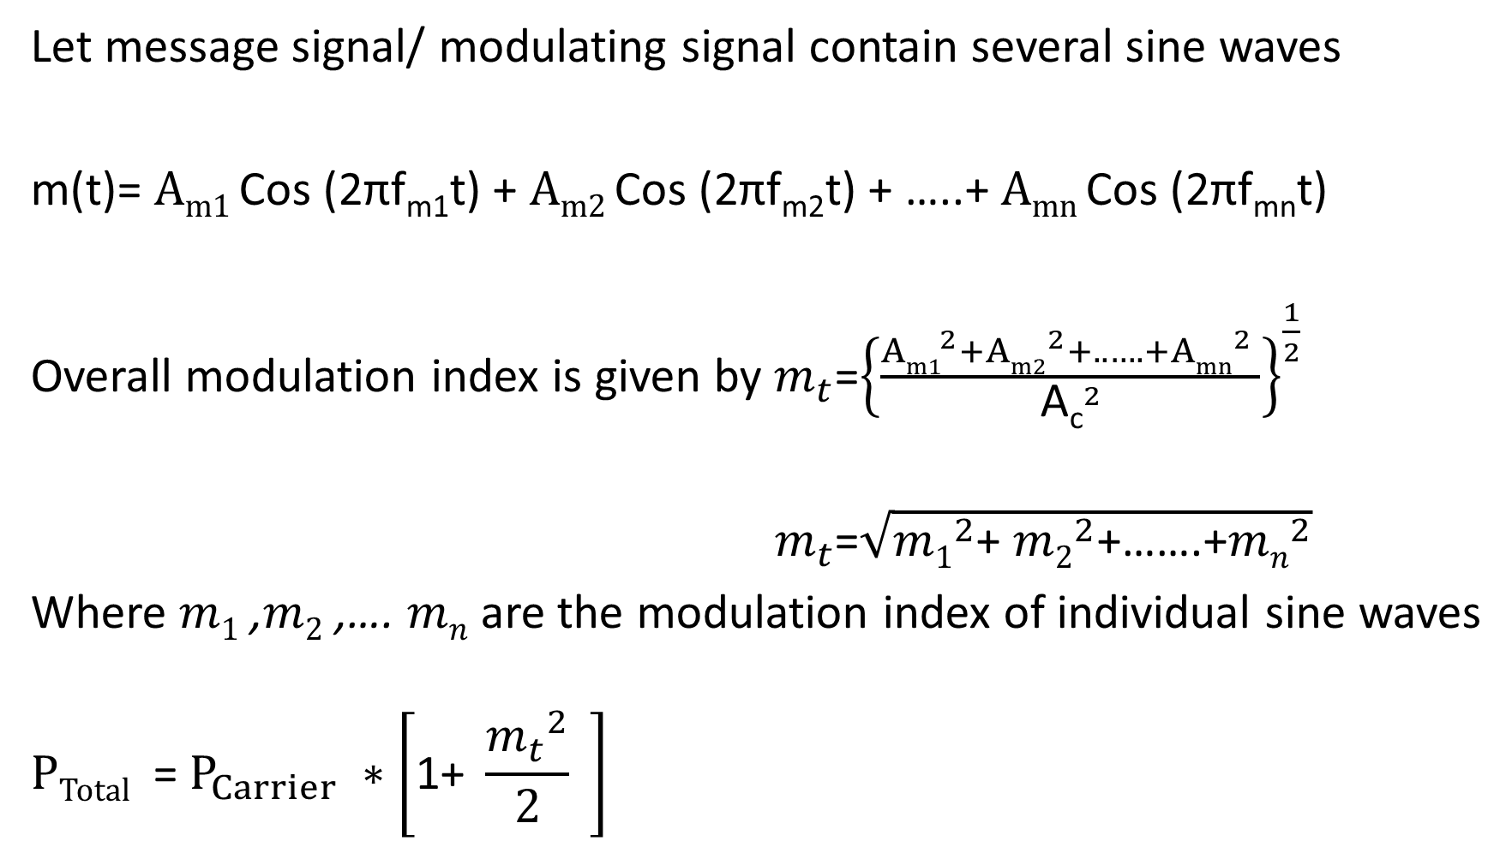
Modulation by several Sine waves
Let message signal/ modulating signal contain several sine waves
m(t)= $Am1$ Cos (2πf_{m1}t) + $Am2$ Cos (2πf_{m2}t) + …..+ $Amn$ Cos (2πf_{mn}t)
Overall modulation index is given by $m_{t}$=${\left\{\frac{{Am1}^{2}+{Am2}^{2}+..….+{Amn}^{2} }{{\text{A}\text{c}}^{2}}\right\}}^{\frac{1}{2}}$
$m_{t}$=$\sqrt{{m1}^{2}\text{+ }{m2}^{2}\text{+…….+}{mn}^{2}}$
Where $m1$ ,$m2$ ,…. $mn$ are the modulation index of individual sine waves
$${PTotal\text{ =} P}_{Carrier} ∗\left[\text{1+} \frac{{m_{t}}^{2}}{2} \right]$$

Slide 16

Current Equation
$ITotal$ = $I_{Carrier} ∗$ $\sqrt{\left[\text{1}\text{+} \frac{m^{2}}{2} \right]}$

Slide 17
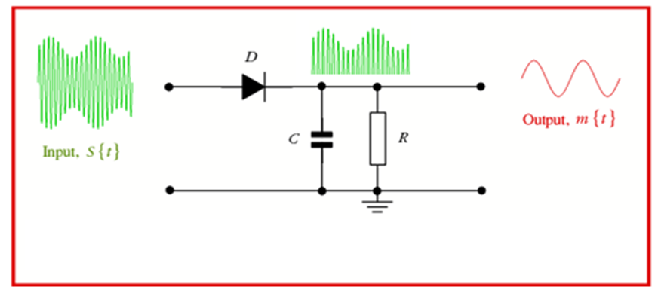
AM Detection

Slide 18
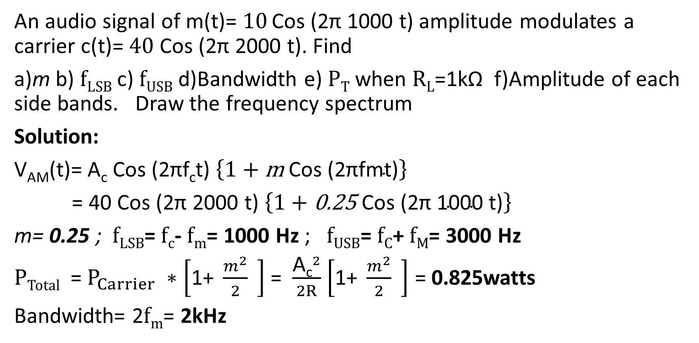
Exercise 01
An audio signal of m(t)= $10$ Cos (2π 1000 t) amplitude modulates a carrier c(t)= $40$ Cos (2π 2000 t). Find
a)m b) $fLSB$ c) $fUSB$ d)Bandwidth e) $PT$ when $RL$=1kΩ f)Amplitude of each side bands. Draw the frequency spectrum
Solution:
$\text{V}\text{AM}$(t)= A_{c} Cos (2πf_{c}t) $\left\{1+\text{m} \text{Cos}\text{ (2}\text{πfmt}\text{)}\right\}$
= 40 Cos (2π 2000 t) $\left\{1+\text{0.25} \text{Cos}\text{ (2}\text{π}\text{ 1000 }\text{t}\text{)}\right\}$
m= 0.25 ; $fLSB$= $fc$- $fm$= 1000 Hz ; $fUSB$= $fC$+ $fM$= 3000 Hz
$PTotal$ = $P_{Carrier} ∗\left[\text{1+} \frac{m^{2}}{2} \right]$ = $\frac{{\text{A}\text{c}}^{2}}{2R}$ $\left[\text{1+} \frac{m^{2}}{2} \right]$ = 0.825watts
Bandwidth= 2$fm$= 2kHz

Slide 19
Spectrum
40 volts
5 volts
5 volts
1 k Hz
2 kHz
3 kHz
BW= 2kHz

Slide 20
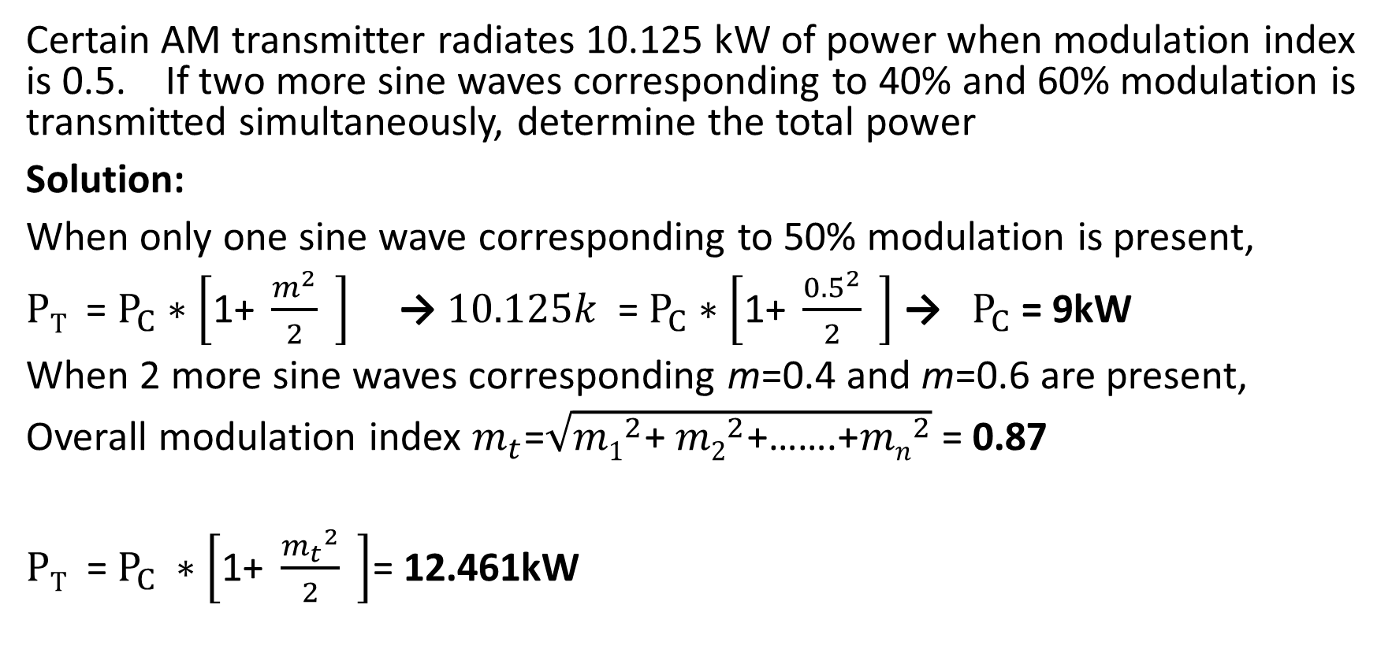
Exercise 02
Certain AM transmitter radiates 10.125 kW of power when modulation index is 0.5. If two more sine waves corresponding to 40% and 60% modulation is transmitted simultaneously, determine the total power
Solution:
When only one sine wave corresponding to 50% modulation is present,
$PT$ = $P_{C}∗\left[\text{1}\text{+} \frac{m^{2}}{2} \right]$ → $10.125k$ = $P_{C}∗\left[\text{1}\text{+} \frac{{0.5}^{2}}{2} \right]$ → $P_{C}$ = 9kW
When 2 more sine waves corresponding m=0.4 and m=0.6 are present,
Overall modulation index $m_{t}$=$\sqrt{{m1}^{2}\text{+ }{m2}^{2}\text{+}\text{……}\text{.+}{mn}^{2}}$ = 0.87
${PT\text{ =} P}_{C} ∗\left[\text{1}\text{+} \frac{{m_{t}}^{2}}{2} \right]$= 12.461kW

Slide 21
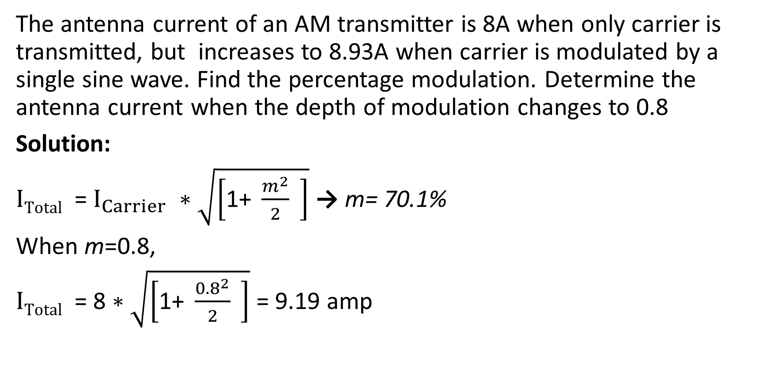
Exercise 03
The antenna current of an AM transmitter is 8A when only carrier is transmitted, but increases to 8.93A when carrier is modulated by a single sine wave. Find the percentage modulation. Determine the antenna current when the depth of modulation changes to 0.8
Solution:
$ITotal$ = $I_{Carrier} ∗$ $\sqrt{\left[\text{1+} \frac{m^{2}}{2} \right]}$ → m= 70.1%
When m=0.8,
$ITotal$ = 8 $∗$ $\sqrt{\left[\text{1+} \frac{{0.8}^{2}}{2} \right]}$ = 9.19 amp

Slide 22
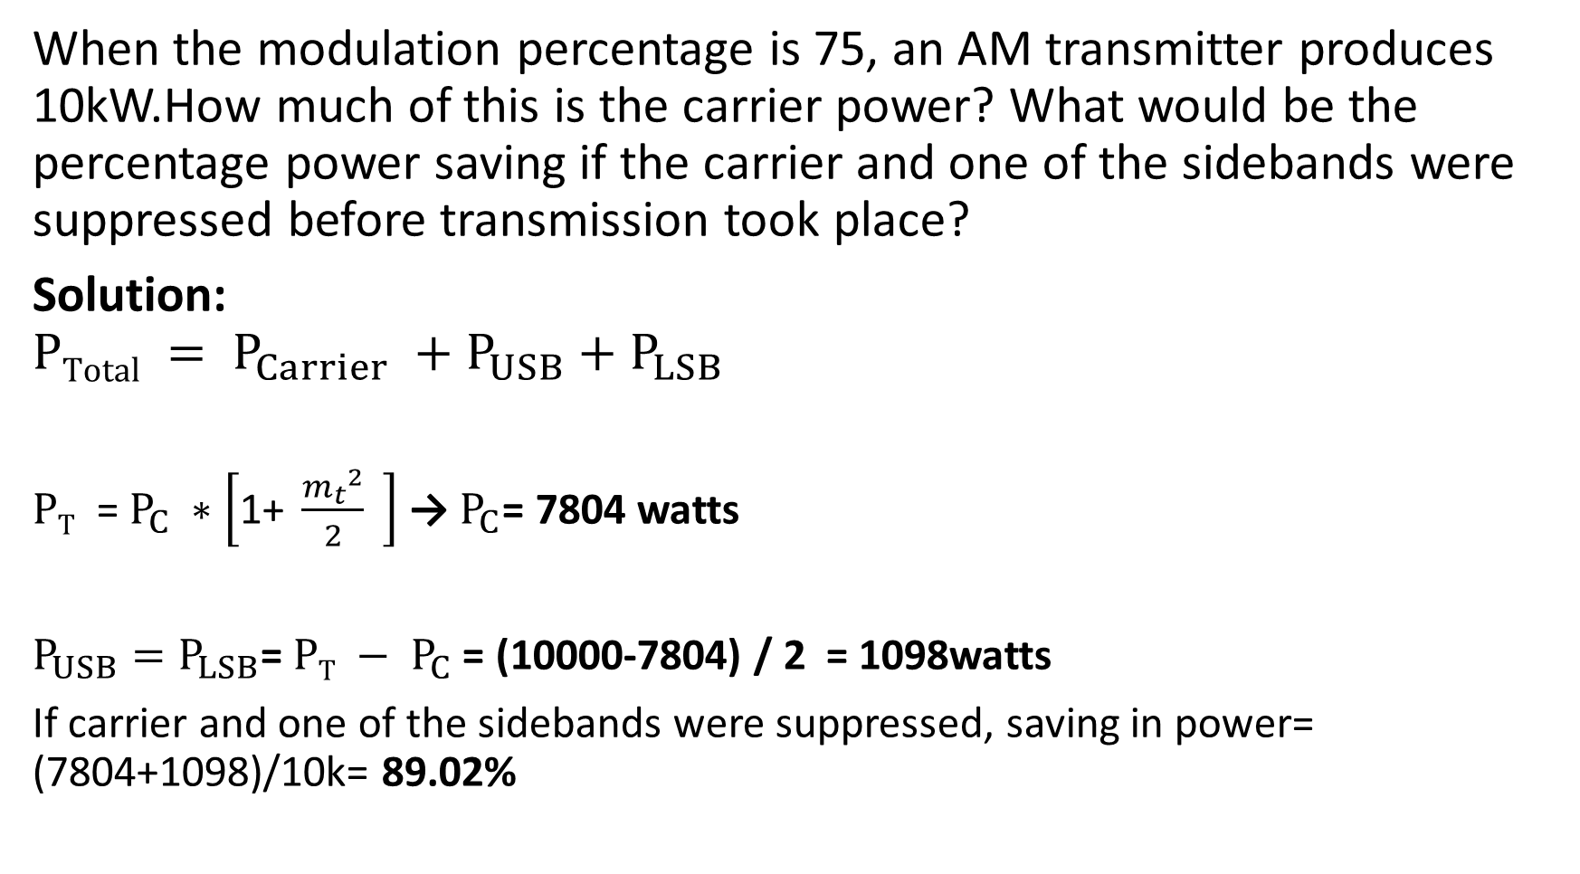
Exercise 04
When the modulation percentage is 75, an AM transmitter produces 10kW.How much of this is the carrier power? What would be the percentage power saving if the carrier and one of the sidebands were suppressed before transmission took place?
Solution:
$$PTotal = P_{Carrier} +P_{USB}+P_{LSB}$$
${PT\text{ =} P}_{C} ∗\left[\text{1}\text{+} \frac{{m_{t}}^{2}}{2} \right]$ →$P_{C}$= 7804 watts
$P_{USB}=P_{LSB}$= ${PT − P}_{C}$ = (10000-7804) / 2 = 1098watts
If carrier and one of the sidebands were suppressed, saving in power= (7804+1098)/10k= 89.02%

Slide 23
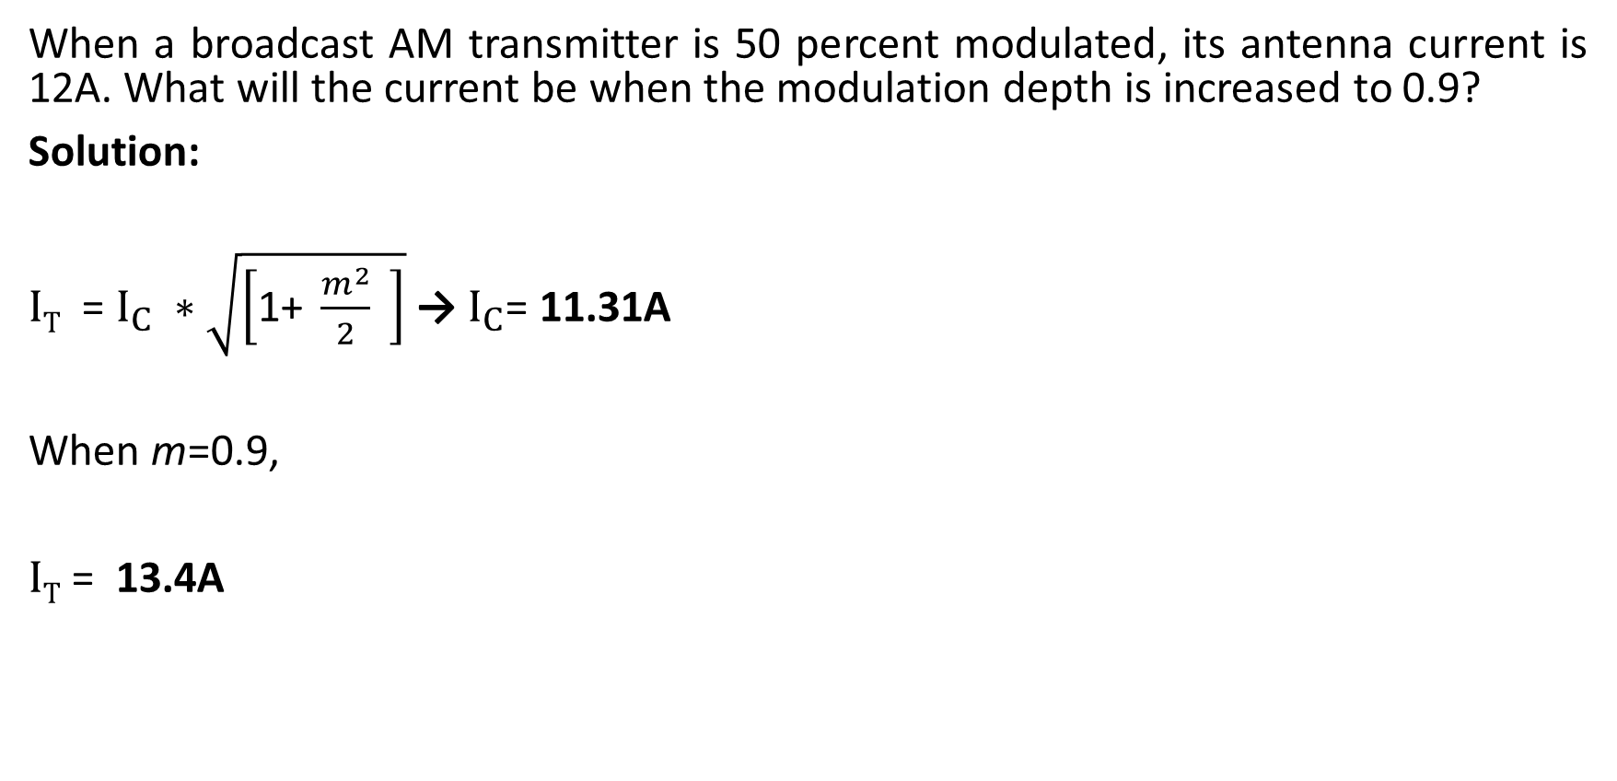
Exercise 05
When a broadcast AM transmitter is 50 percent modulated, its antenna current is 12A. What will the current be when the modulation depth is increased to 0.9?
Solution:
$IT$ = $I_{C} ∗$ $\sqrt{\left[\text{1}\text{+} \frac{m^{2}}{2} \right]}$ → $I_{C}$= 11.31A
When m=0.9,
$IT$ = 13.4A

Slide 24
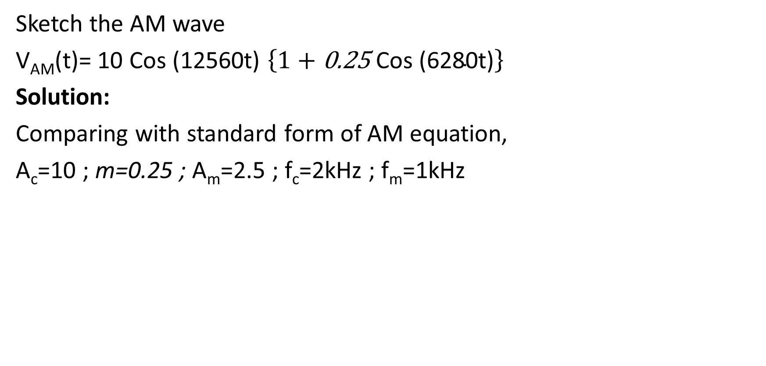
Exercise 06
Sketch the AM wave
$\text{V}\text{AM}$(t)= 10 Cos (12560t) $\left\{1+\text{0.25 }\text{Cos}\text{ (6280}\text{t}\text{)}\right\}$
Solution:
Comparing with standard form of AM equation,
A_{c}=10 ; m=0.25 ; A_{m}=2.5 ; f_{c}=2kHz ; f_{m}=1kHz

Slide 25
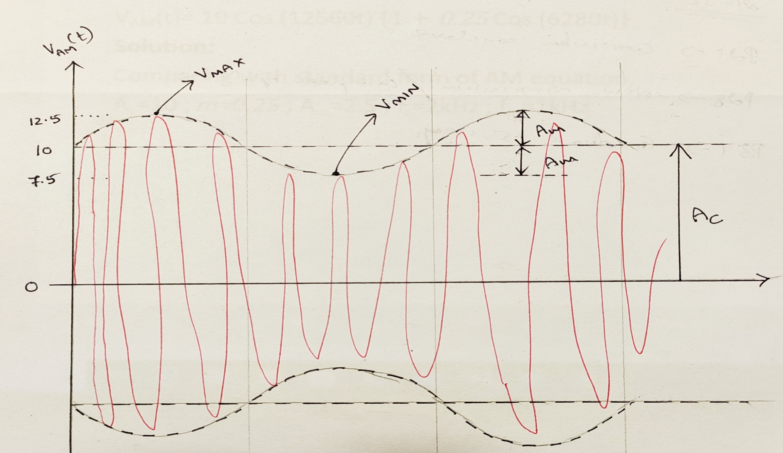

Slide 26
Frequency Modulation
Process of altering the frequency of the carrier signal with respect to the instantaneous amplitude of the modulating signal.
Both Carrier and Message are analog
Modulating Signal(Message) + Carrier Signal = Frequency Modulated Signal

Slide 27
FM Waveform

Slide 28
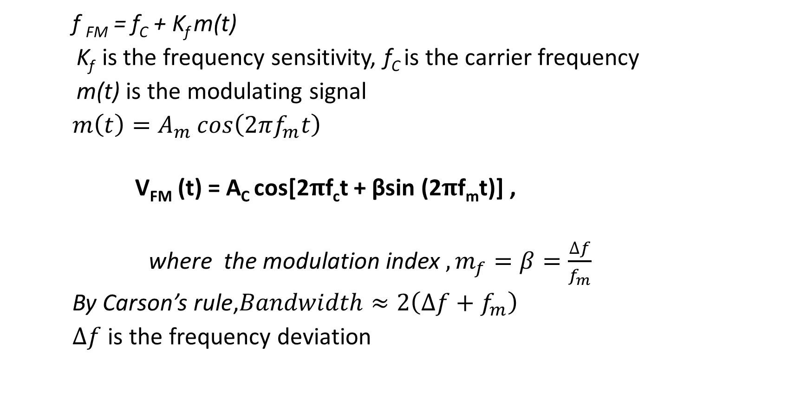
Representation of FM Wave
f _{FM} = f_{C} + K_{f} m(t)
K_{f} is the frequency sensitivity, f_{C} is the carrier frequency
m(t) is the modulating signal
$m\left(t\right)=A_{m}\cos\left(2πf_{m}t\right)$
V_{FM} (t) = A_{C} cos[2$π$f_{c}t + βsin (2$π$f_{m}t)] ,
where the modulation index $, m_{f}=β=\frac{∆f}{f_{m}}$
By Carson’s rule,$Bandwidth≈2\left(∆f+f_{m}\right)$
$∆f$ is the frequency deviation

Slide 29
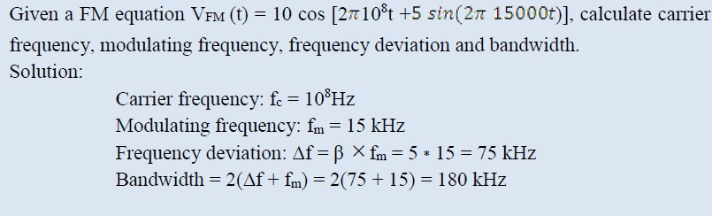
Exercise 01

Slide 30
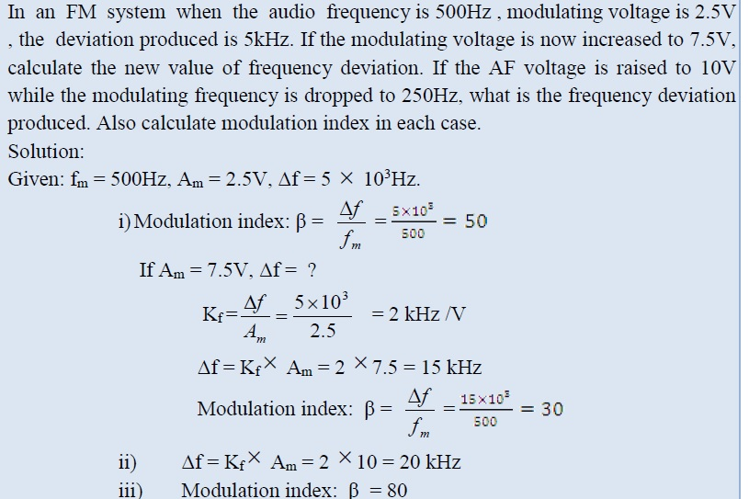
Exercise 02

Slide 31
PULSE MODULATION TECHNIQUES

Slide 32
Digital Transmission of Analog Data
Message Signal → Analog
Carrier Signal → Digital
Types
Pulse Amplitude Modulation (PAM)
Pulse Width Modulation (PWM)
Pulse Position Modulation (PPM)

Slide 33
Pulse Amplitude Modulation(PAM)
Here the signal is sampled at regular intervals and each sample is made proportional to the amplitude of the message signal at the instant of sampling.

Slide 34
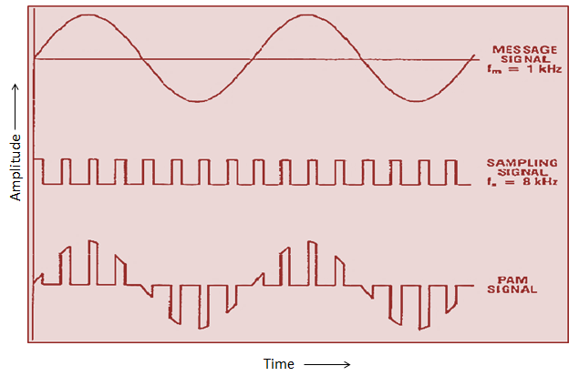
PAM Waveform

Slide 35
Pulse Width Modulation(PWM)
Here the amplitude and starting time of each pulse is fixed but the width of each pulse is made proportional to the amplitude of the modulating analog signal at that instant

Slide 36
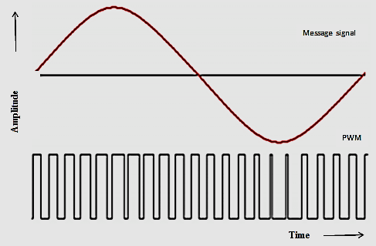
PWM Waveform

Slide 37
Pulse Position Modulation(PPM)
Both the amplitude and the duration are kept constant while the position of each pulse in relation to the position of a recurrent reference pulse is varied by each instantaneous sampled value of the modulating signal
Note: Fixed amplitude & Fixed width pulse at every falling edge of PWM wave

Slide 38
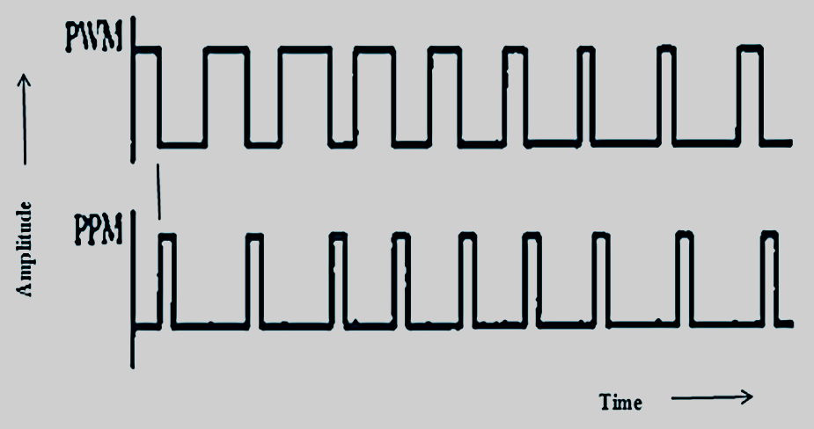
PPM Waveform

Slide 39
Digital Modulation Techniques
Message Signal → Digital
Carrier Signal → Analog
Types
Amplitude Shift Keying (ASK)
Frequency Shift Keying (FSK)
Phase Shift Keying (PSK)

Slide 40
Amplitude Shift Keying (ASK)
Amplitude of the carrier is changed in accordance with the binary information to be transmitted
Frequency and phase of the carrier are kept fixed.
Bit 1 is transmitted by a carrier of one particular amplitude. Bit 0 is transmitted by changing the amplitude to 0 Volt or no signal in this case.

Slide 41
Waveform

Slide 42
Frequency Shift Keying (FSK)
Frequency of the carrier is changed in accordance with the binary information.
One frequency for bit 1 and another frequency for bit 0.

Slide 43
Waveform
.

Slide 44
Phase Shift Keying (PSK)
Phase of the sinusoidal carrier is changed in accordance with the binary information.
Phase in this context is the starting angle at which the sinusoid starts.
To transmit bit 0, the phase of the sinusoid is shifted by 180o whereas to transmit bit 1, the phase of the sinusoidal carrier is shifted by another 180o.
Thus the carrier phase shift represents the change in the state of the information.

Slide 45
Waveform

